Slide 1
Demo on Unit Test Project

Slide 2
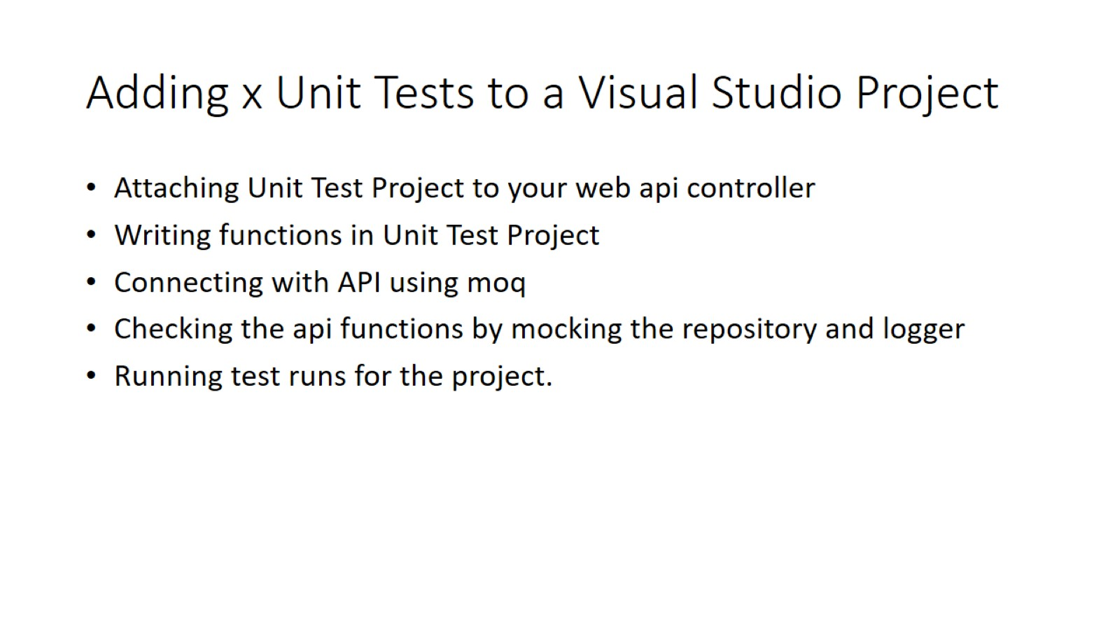
Adding x Unit Tests to a Visual Studio Project
AGENDA

Slide 3
Why Unit Testing?
Unit Tests save time. Unit tests can be run at the press of a button
With unit testing, it's possible to rerun your entire suite of tests after every build or even after you change a line of code.
When you have a suite of well-named unit tests, each test should be able to clearly explain the expected output for a given input.

Slide 4
Characteristics of a good unit test
Fast. It is not uncommon for mature projects to have thousands of unit tests. Unit tests should take very little time to run. Milliseconds.
Isolated. Unit tests are standalone, can be run in isolation, and have no dependencies on any outside factors such as a file system or database.
Repeatable. Running a unit test should be consistent with its results, that is, it always returns the same result if you do not change anything in between runs.
Self-Checking. The test should be able to automatically detect if it passed or failed without any human interaction.

Slide 5
Naming your tests
The name of your test should consist of three parts:
The name of the method being tested.
The scenario under which it's being tested.
The expected behavior when the scenario is invoked.
Example : Add_SingleNumber_ReturnsSameNumber
Naming standards are important because they explicitly express the intent of the test.

Slide 6
Two modes for connecting with API
Without using moq
Using moq – moq mocking library is used – our topic

Slide 7
Terms used in Unit Testing
Mock - A mock object is a fake object in the system that decides whether a unit test has passed or failed. A mock starts out as a Fake until it's asserted against.
Stub - A stub is a controllable replacement for an existing dependency (or collaborator) in the system. By using a stub, you can test your code without dealing with the dependency directly.
By default, a stub and mock starts out as a fake.

Slide 8
Two Kinds of tests in Xunit Class
Fact tests - not parameterized and cannot take outside input
Theory tests - these tests are parameterized and can take outside input
Example Fact :
[Fact]
public void Check_Equality_ReturnsSame()
{
Assert.Equal(1, 1);
}

Slide 9
Introducing MOQ Library – Mock Class
// Example Using MOQ library – Mock Keyword is used for mocking object creation
// MOCK Controller Object is created, and the interfaces used in the controller are also mocked
// Arrange
private readonly Mock<ILogger<TaskInfoController>> loggerStub = new();
private readonly Mock<ITaskProvider> providerStub = new();

Slide 10
[Theory]
[InlineData(1, "Setting up the Environment for the Project")]
public void Test_Get_Function_Invoking_Controller(int TaskId, string name)
{
var controllerObject = new TaskInfoController(providerStub.Object, loggerStub.Object);
// Act
string result = controllerObject.FetchTaskName(TaskId);
// Assert
Assert.Equal(name, result);
}

Slide 11
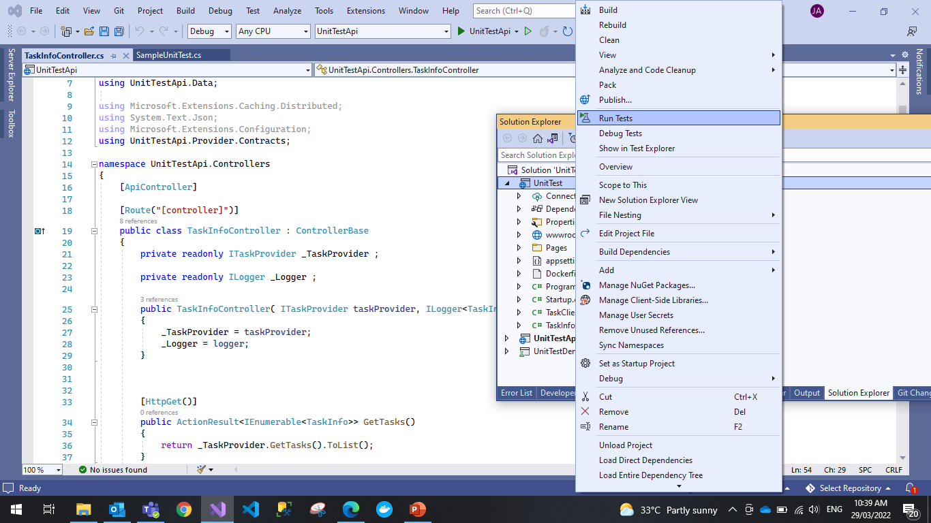

Slide 12
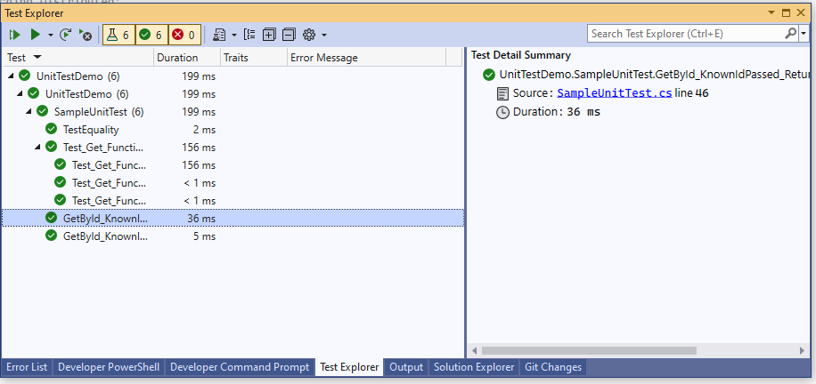
Test Explorer showing the output of tests

Slide 13

MOQ – Mocking Library
Moq Documentation

Slide 14
Assert Functions
Assert.Equal
Assert.IsNotNull
Assert.NotNull

Slide 15
References
Methods under Assert Class
Documentation for Assert

